Slide 1
Cloudera AI Overview
July 2025

Slide 2
Table of contents
Cloudera AI Overview
Why Cloudera AI
Key Cloudera AI Capabilities
Other Critical AI-Enabling Technologies from Cloudera
Customer Success Stories

Slide 3

Cloudera’s Data and AI Maturity
Cloudera AI Overview
Where we were, where we are, where we’re going
2008-2019
2021
2022
2023
2024
Next
Cloudera founded by former Google, Yahoo, and Oracle employees
Acquired Sense.io in 2017 to enter the Data Science and ML Platform market
Intel largest private Big Data technology investment — $742M in Cloudera
Cloudera and Hortonworks combine to address hybrid and AI opportunity
Cloudera goes private in $5.3B deal to deliver hybrid cloud vision
Delivered first true hybrid platform for data,analytics, and AI for scale, flexibility, and value
Key innovations & support — multi- clouds, Apache Iceberg, Apache Ozone, Data Observability, and more
Accelerated investment, with focus on hybrid platforms, open data lakehouse, & enterprise
Launched industry’s first Enterprise AI ecosystem
Acquired Verta’s Operational AI Platform and Octopai’s Data Intelligence Platform
The next wave of Enterprise AI from Cloudera

Slide 4






Cloudera AI: The Flexible, Enterprise-Grade AI / ML Platform – On Prem & in the Cloud
Cloudera AI Overview
270+
Enterprise-grade customers using Cloudera AI
Customer validation: Cost savings, performance, flexibility, enterprise scale
“We prioritize using Cloudera AI for scenarios involving GPU-intensive tasks where execution speed and cost efficiency are critical on the cloud and on premise. Cloudera's platform excels in providing a secure, well-governed data management system, making it the preferred choice for organizations looking to optimize performance and cost.– Director of Architecture, Global Research & Consulting Co.
“A high school-aged intern delivered a complex AI/ML model in 10 weeks on Cloudera AI. With the speed of onboarding on Cloudera AI, we see tangible and immediate value.” - Head of AI, Global Pharma Co.
“We realized early on that what we were trying to achieve was going to push the limits of the technology we had. And Cloudera is with us in the trenches every day … with a commitment to see this through and make it successful.” - Platform Program Lead, Global Pharma Co.

Slide 5

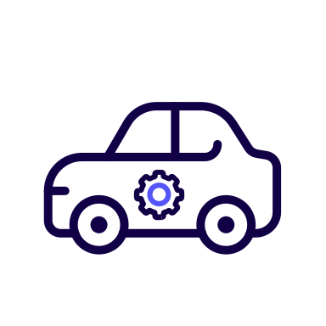



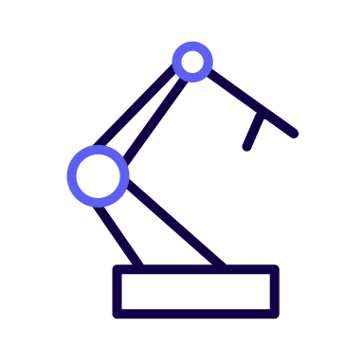


Critical use cases powered by Cloudera AI in Financial Services (non-exhaustive)
Cloudera AI Overview
KYC onboarding and assistant (agent)
Fraud and scam detection (Real Time)
Fulfillment bots
(RAG Intent fulfillment)
Enhanced 360 customer overview
Financial analysis for credit risk offer
Wealth advisor stock selector
Real time push notification engine
Credit risk modeling and scorecard for RT decisioning
News monitoring in real time
Churn prediction
©2025 Cloudera, Inc. All Rights Reserved.

Slide 6
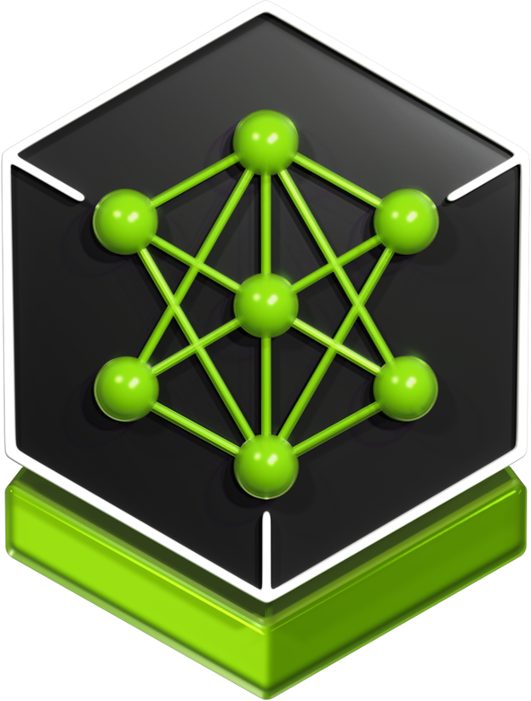
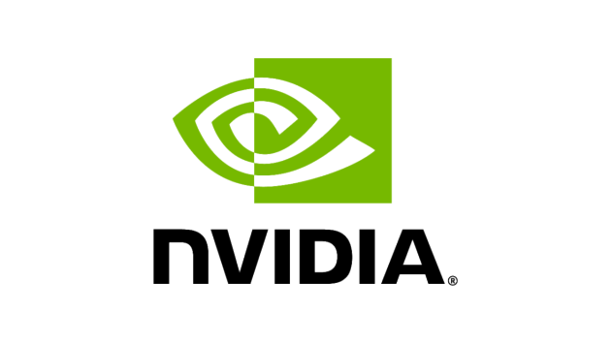
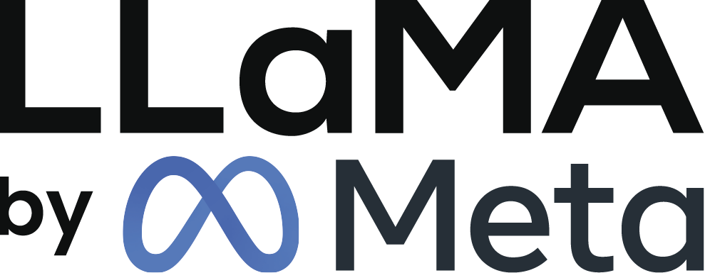
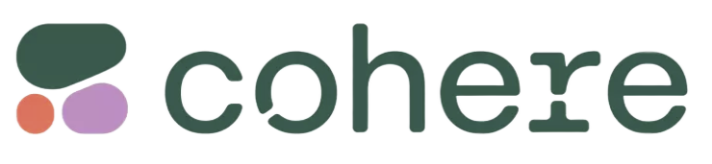


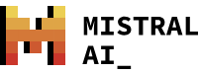

Cloudera AI Overview
Cloudera AI: Accelerating World-Class AI Apps & Agents
Development
Production
Cloudera AI Workbench
Cloudera AI Inference Service
Applications and Agents
Autoscaling
& High
Availability
Monitoring
Notebooks
AMPs
NVIDIA NIM Microservices
Synthetic Data Studio
Fine Tuning Studio
RAG Studio
Agent Studio
Enterprise Security & Governance
Cloudera AI Registry
Model Training and Fine Tuning
On Premises & On Cloud

Slide 7
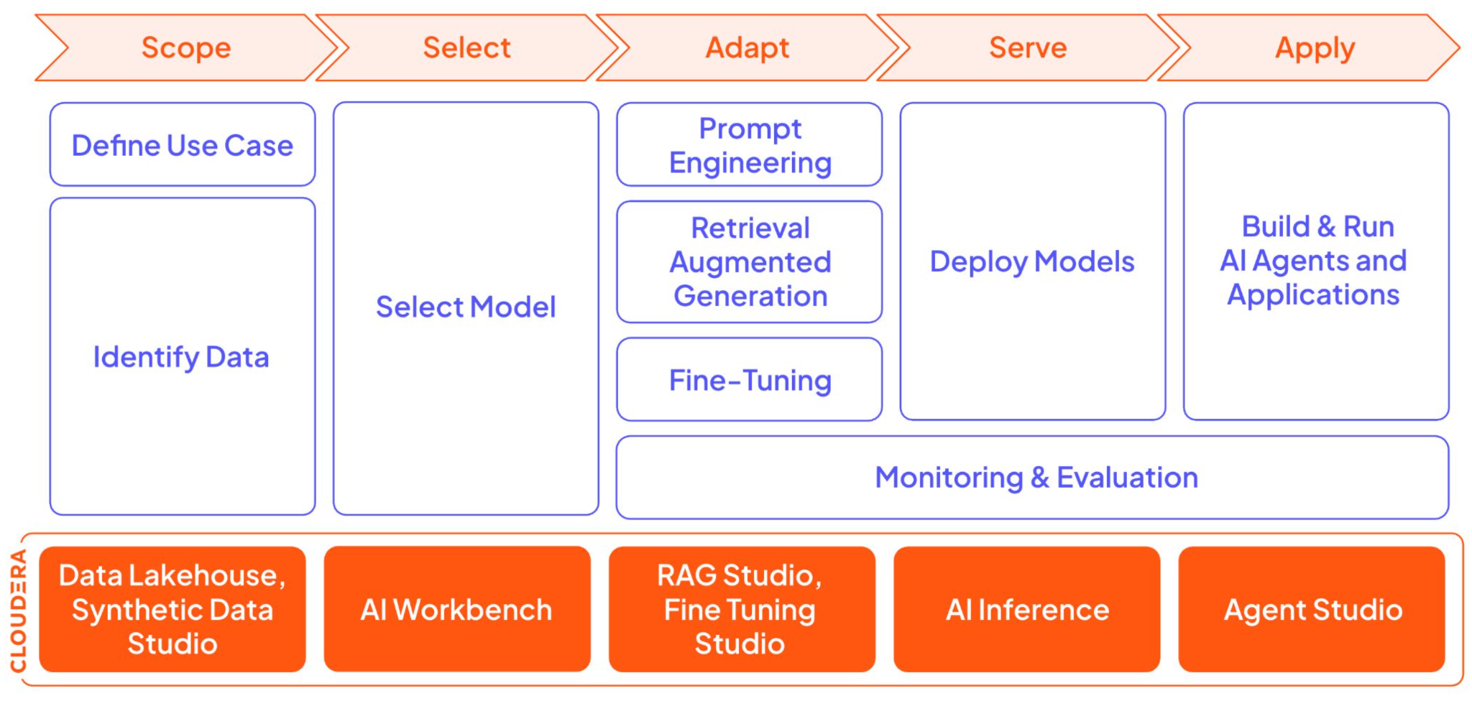
Cloudera AI - Enabling every stage of the Generative AI Lifecycle
Cloudera AI Overview

Slide 8
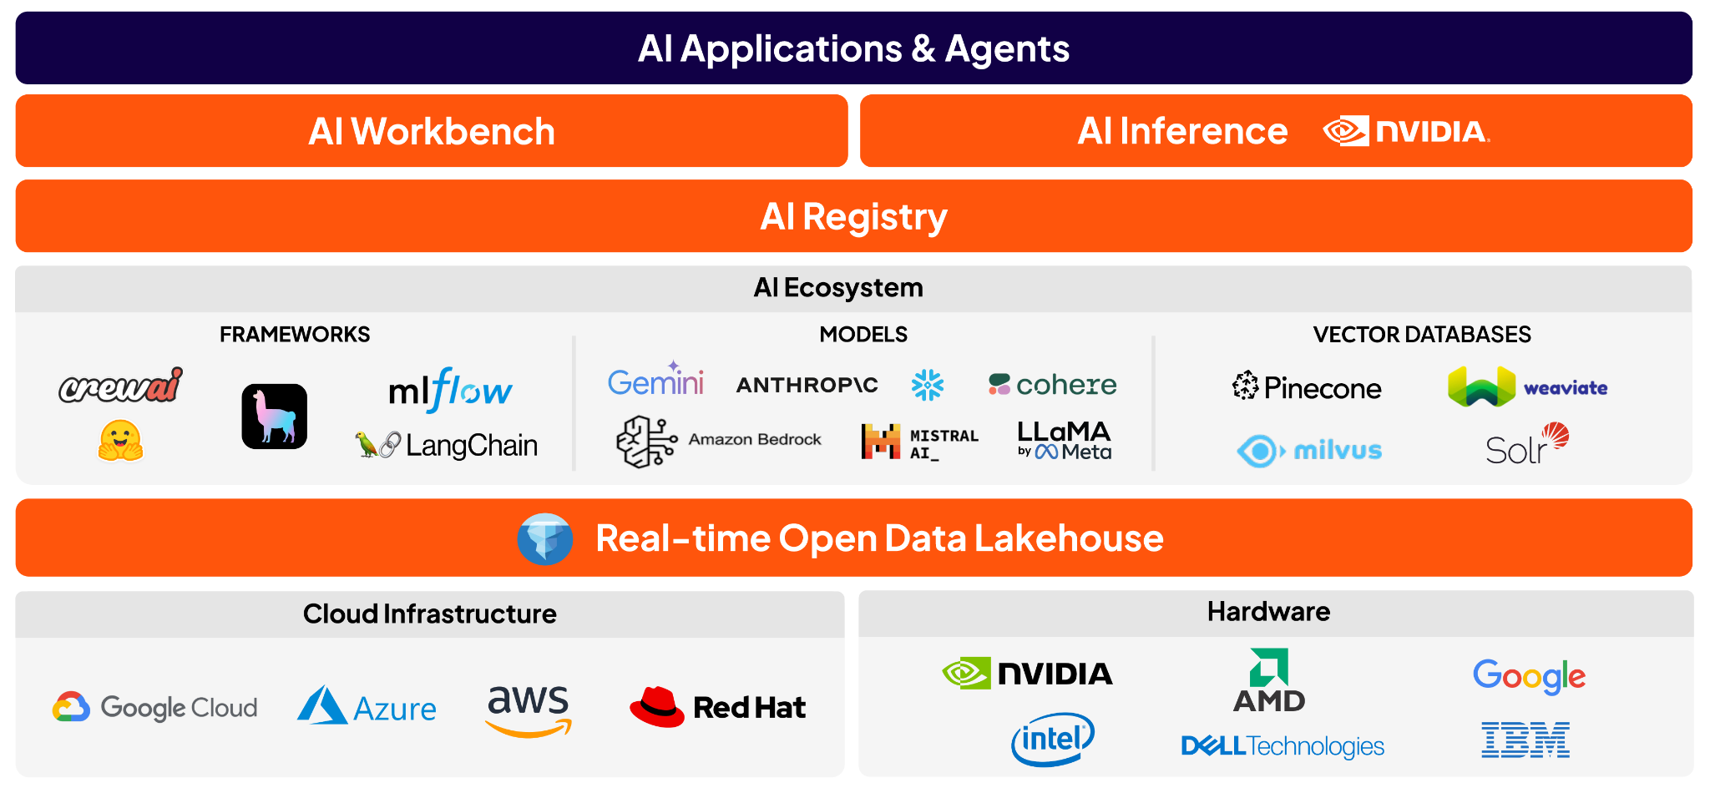
Cloudera AI Ecosystem
Cloudera AI Overview
VLLM

Slide 9


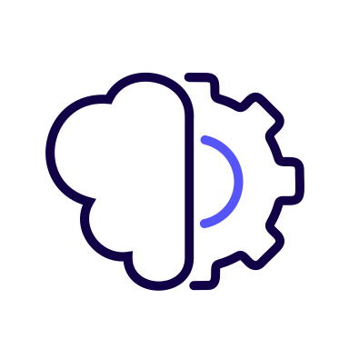

Enterprise AI Strategy Pillars: Cloudera AI expands possible use cases & enables optimal execution
Why Cloudera AI
1
2
3
4
5
Private AI
Trusted data
Any Model
Applications & Agents
Accelerated
Compute Anywhere
Deploy Apps & Model on Public Cloud and On Prem securely within your environment​
Bring your models to the data & leverage industry-leading data lineage and metadata management
Enterprise context for any foundational model, LLM, transformer library​
Build agentic apps with Cloudera AI Workbench, and the AI Ecosystem
Access to GPU’s anywhere - Scaled AI workloads on GPUs with a better TCO​
More use cases with trusted data
Optimal execution with unparalleled tool & deployment flexibility
Notes:
Enterprise AI pillars​
Hardware Acceleration​
Open Platform | Any Model Integration​
Enterprise Search | ML Ops Monitoring​
Applications & Agents​
Models, ​
​

Slide 10

Why Cloudera AI: Cloudera provides the enterprise-grade capabilities & flexibility large banks need
Why Cloudera AI
2
Enterprise scale “How effective & performant it will be when you do it”
Private AI
Cost & performance at scale
Unified end-to-end architecture
Flexibility
Accelerated Time to Value
1
Enterprise scope “What you can do”

Slide 11
Why Cloudera AI: Enterprise scope & scale
Why Cloudera AI
1
Enterprise scope
2
Enterprise scale
FLEXIBILITY
ACCELERATED TIME TO VALUE
PRIVATE AI
COST & PERFORMANCE AT SCALE
UNIFIED ARCHITECTURE
“Right tool for the job” - any library, any model, etc.
Pre-built model templates, i.e., AMPs, Studios, libraries, etc.
Local model embeddings & LLMs
Deployments at unmatched enterprise scale
Unified Edge to AI - warehousing, ETL, streaming, etc.
Interoperability with CSPs via Notebooks, Python, etc.
Accelerated inference service, including NVIDIA NIMs
Bring the models to your data
Optimized app performance, with NVIDIA NIMs
Mitigated integration tax costs (data engineering, ops, etc.)
No vendor lock-in; hybrid & multi-cloud workload portability
Avoid integration delays with pre-built Cloudera integrations
Regulatory compliance & data lineage
Resource monitoring & optimization at enterprise scale
Unified security & governance with a single pane of glass

Slide 12

Key Capabilities
Notes:
Demo with voiceover

Slide 13
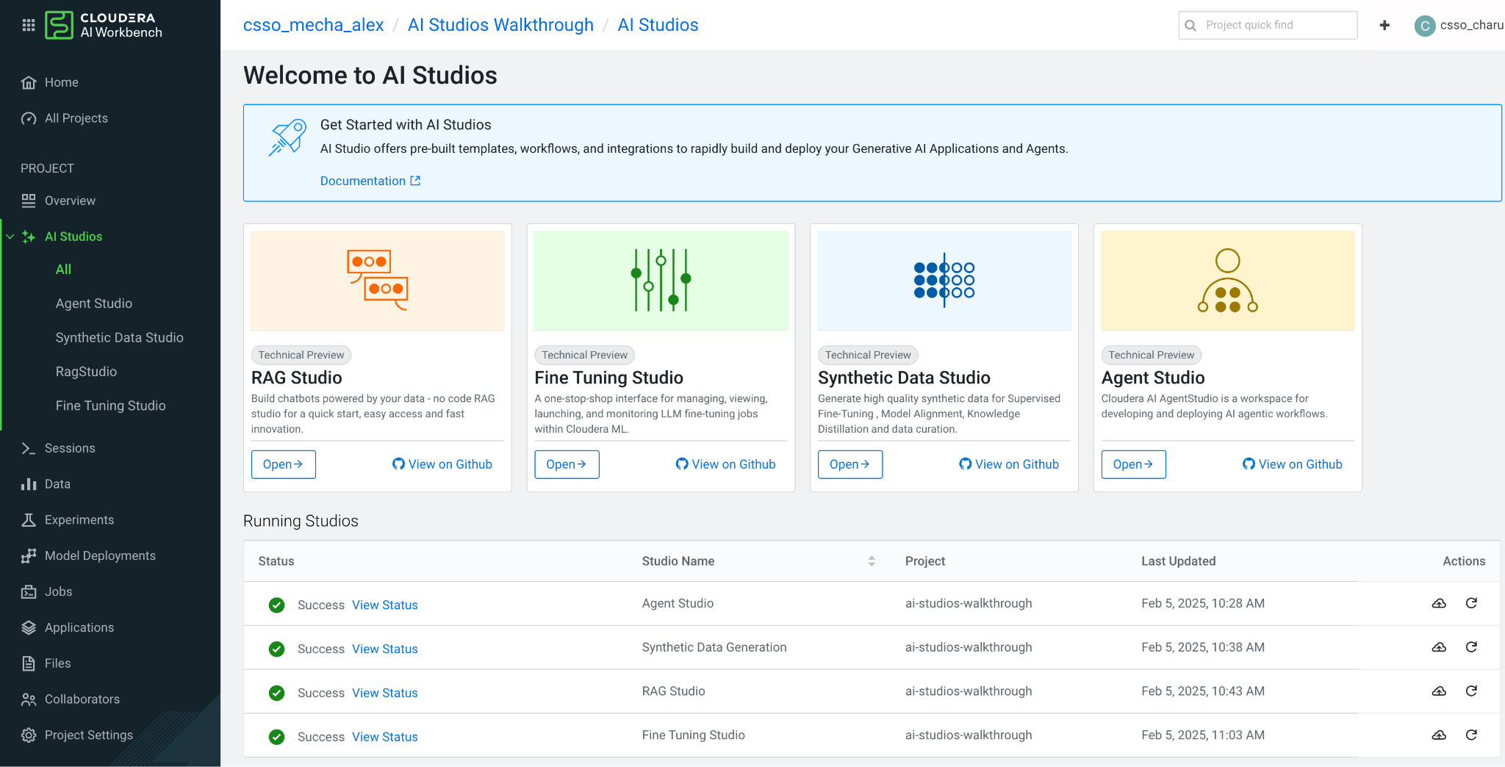

Introducing AI Studios
Key Capabilities
Rapidly build GenAI Applications and Agents

Slide 14
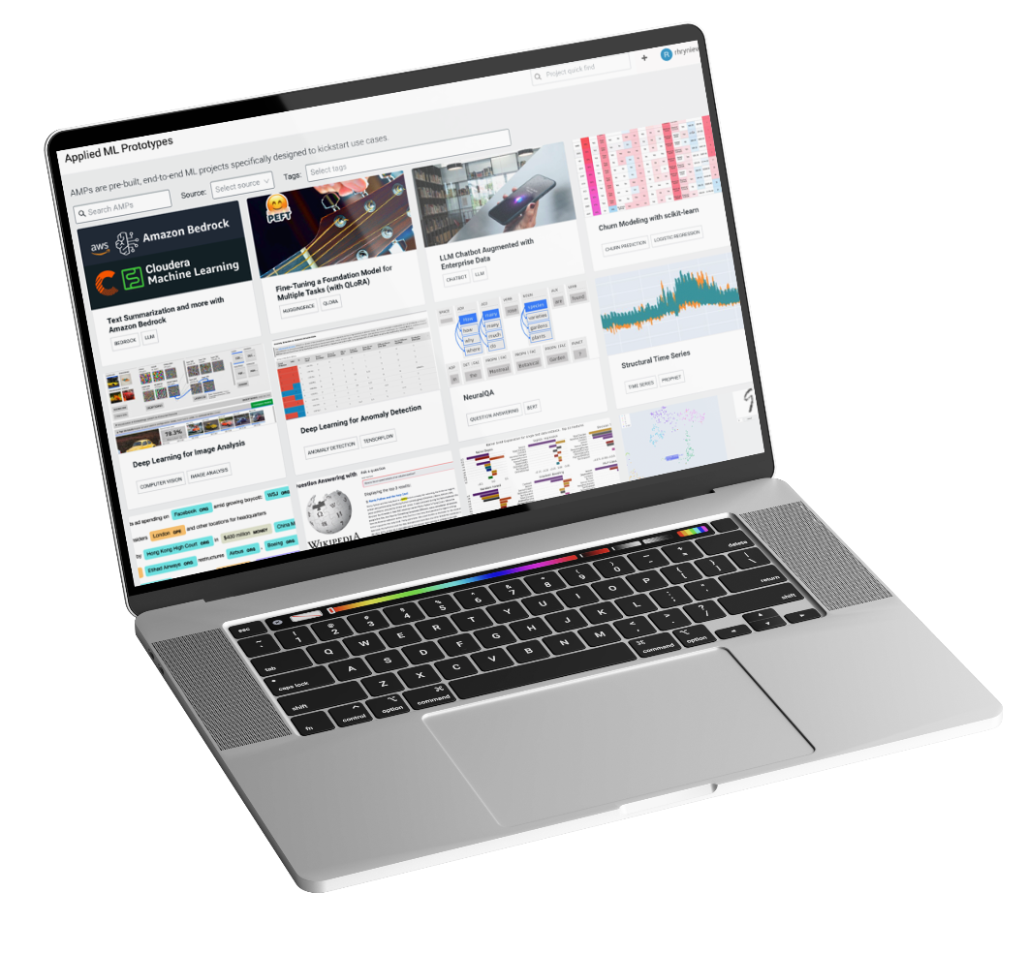
Accelerators for AI/ML Projects (AMPs)
Key Capabilities
One-click deployment of Commonly Used AI/ML Model Projects
Make it easy for end users to be successful on our AI platform
Decrease time to value by providing high-quality reference examples
Leverage Cloudera research expertise to showcase cutting- edge AI/ML techniques

Slide 15
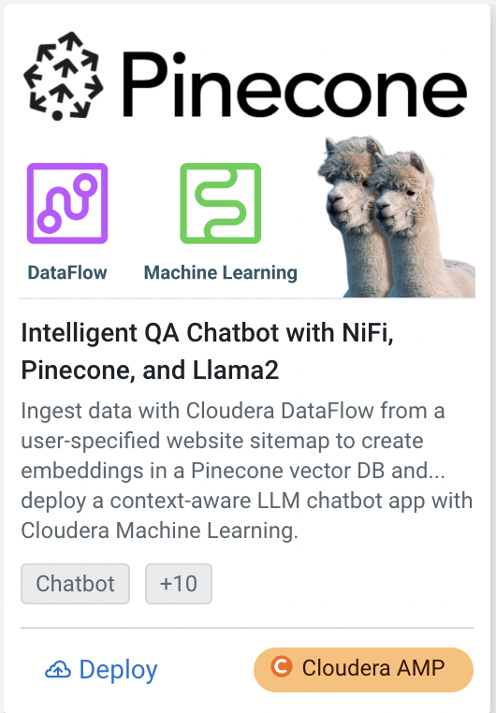
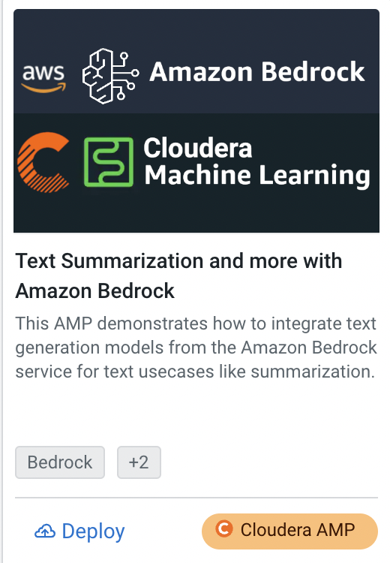
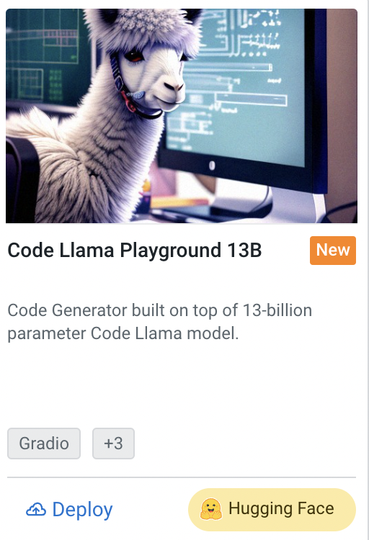
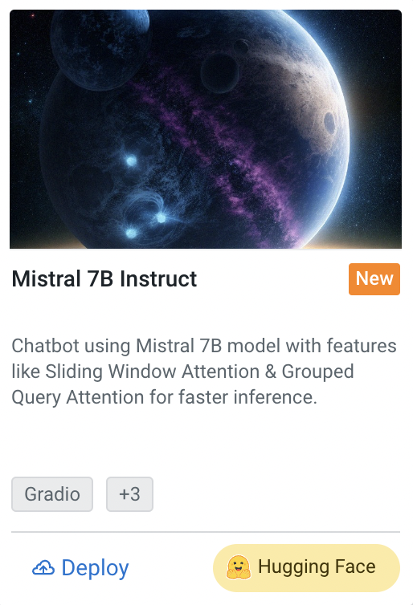
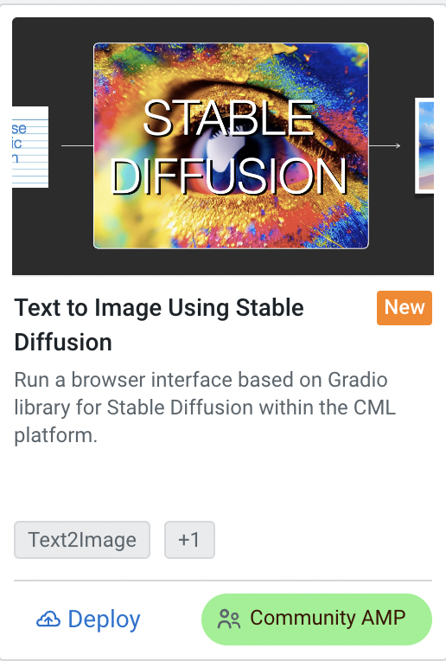
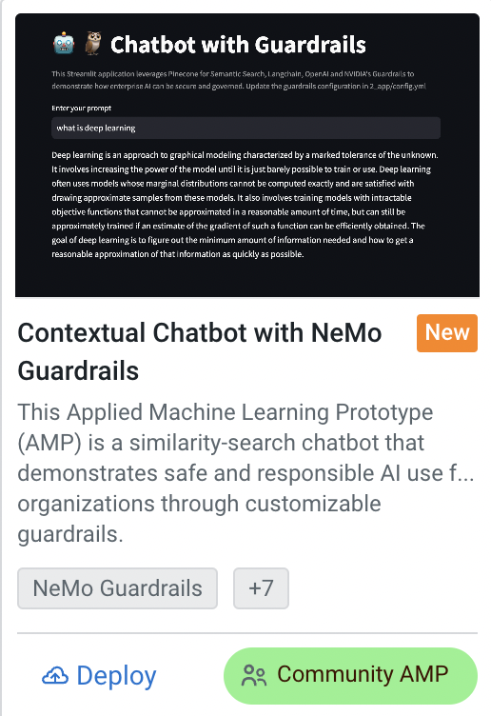
The Next Wave of Generative AI Runs on Cloudera​
Key Capabilities
One-click deployment of commonly used AI/ML model project​
Cloudera
Hugging Face
Community
Illumina
LGIM
ExxonMobil
Bank of Ireland
Large Telco
Bulge Bracket Bank
Notes:
AWS Bedrock:
We are building generative AI capabilities in Cloudera, using the power of Amazon Bedrock, a fully managed serverless service. Customers can quickly and easily build generative AI applications using these new features available in Cloudera.
Pinecone:
Having a strategic partnership that integrates Pinecone’s AI vectorbase expertise into Cloudera’s open data platform aims at transforming the way organizations harness the power of AI to streamline operations and improve customer experiences.
The Cloud based semantic search capabilities will cut down on erroneous outputs (Hallucinations) - helping to guarantee that search and generative AI deliver accurate responses.
Hugging Face
Cloudera is integrating Hugging Faces’ market-leading range of LLMs, generative AI, and traditional pre-trained machine learning models and datasets into Cloudera Data Platform so customers can significantly reduce time-to-value in deploying AI applications.
Community:
AMPs are fully built out ML prototypes that can be deployed with a single click directly from Cloudera Machine Learning . AMPs enable data scientists to go from an idea to a fully working ML use case in a fraction of the time.In line with our ongoing commitment to supporting ML practitioners, Cloudera is thrilled to announce the release of four new Accelerators!

Slide 16
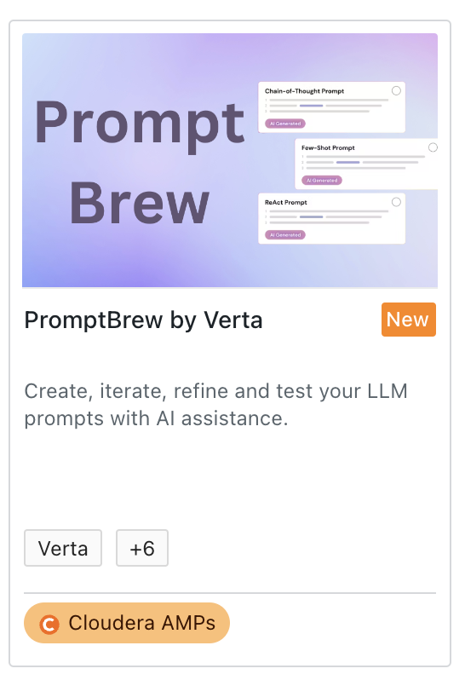
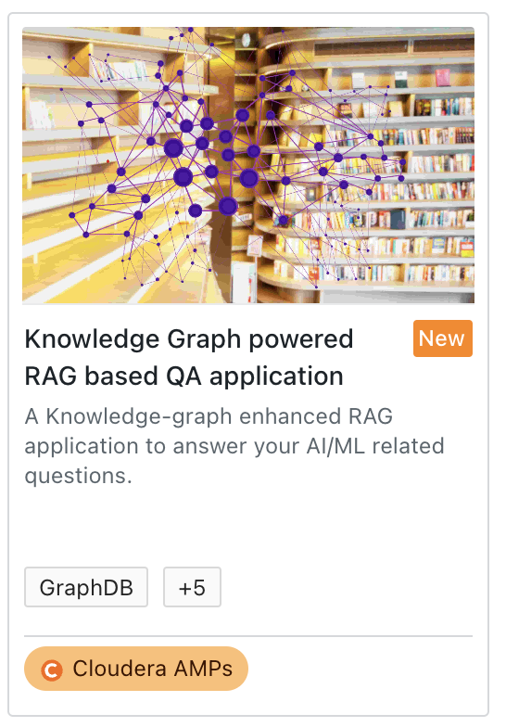
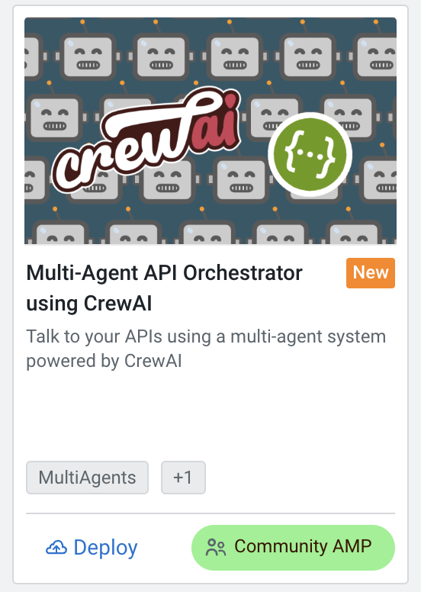
RAG, Knowledge Graphs, and Agents AMPs
Key Capabilities

Slide 17
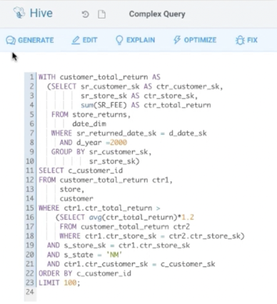
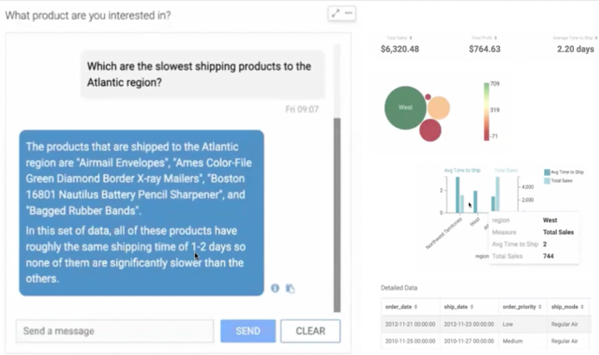
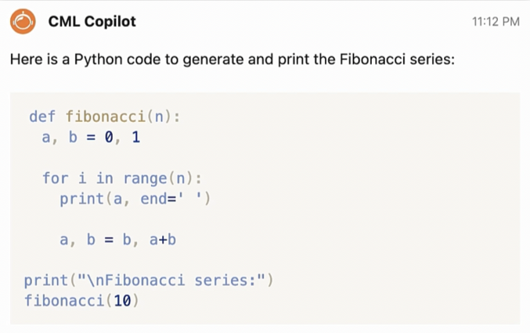
Accelerate AI Adoption - AI Assistants in Cloudera​
Key Capabilities
SQL, BI & ML coding AI assistants built-in Cloudera services​
SQL AI Assistant
BI Chatbot
ML Copilot
Accelerate query development
Make business analysts more effective in answering the “Why”​
Bring new AI apps to production faster​

Slide 18
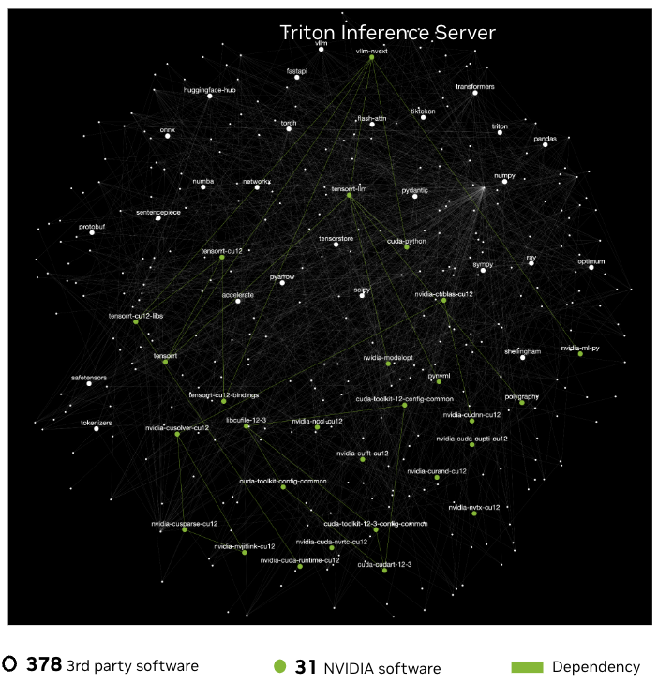
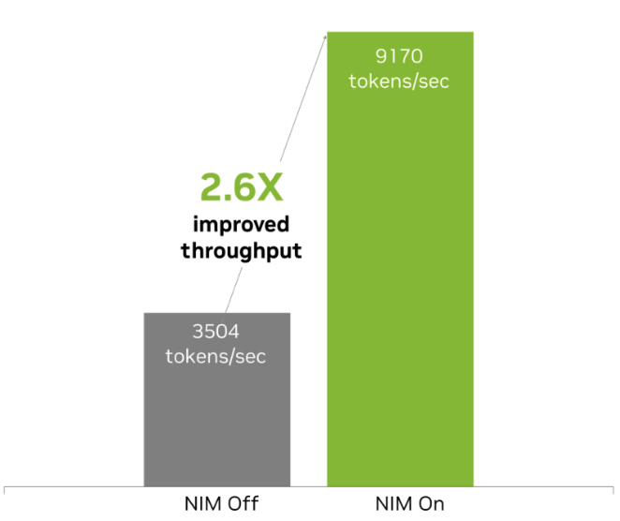
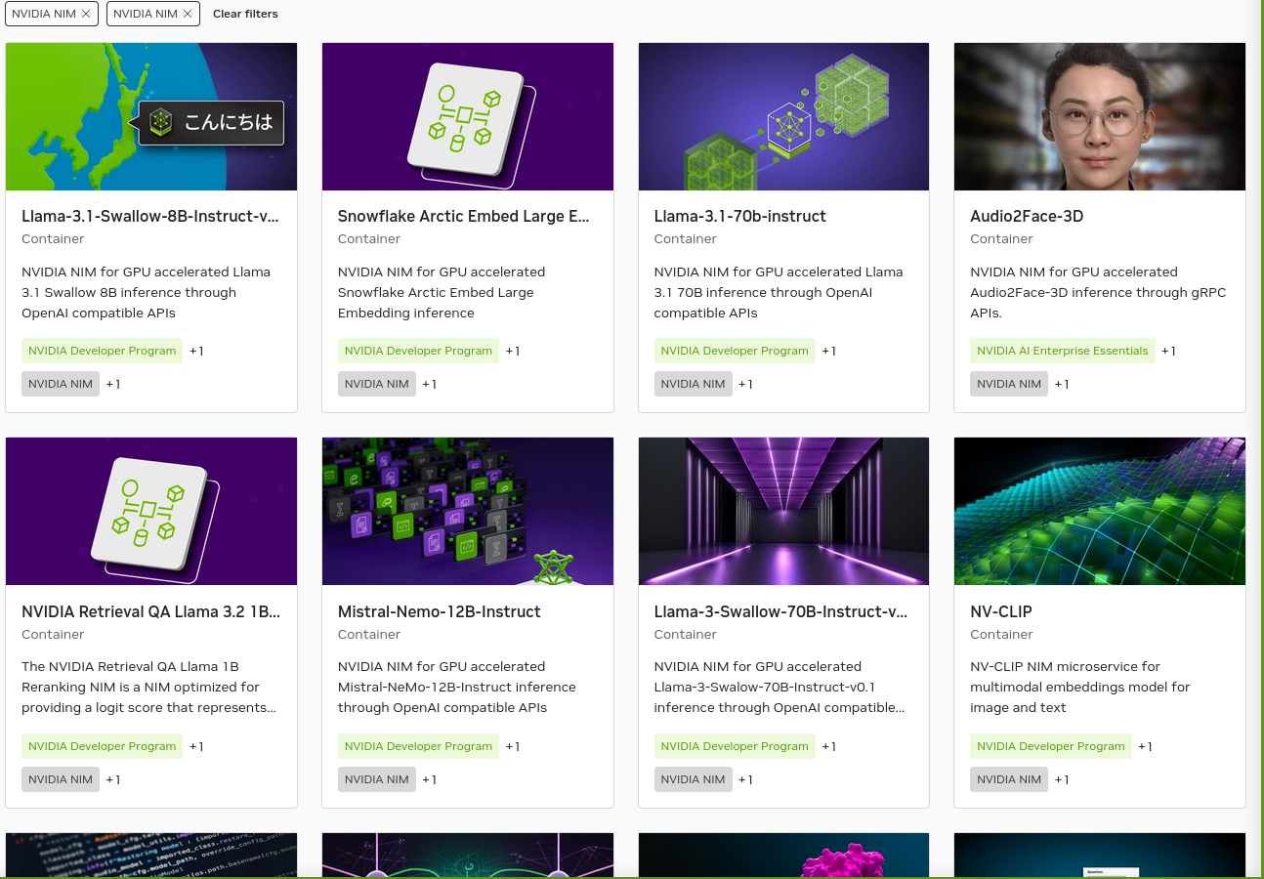
Why Cloudera AI: Cloudera AI and NIM Microservices
Key Capabilities
Optimized and secure models from NVIDIA
Open models
CVE-free and secure
Optimized across the stack
Notes:
NVIDIA NIM provides the best of both worlds. A simple way to deploy AI models that can be developed using a standard API path.
Moving upwards, we've adopted industry-standard APIs in conjunction with NVIDIA Cloud standards to facilitate seamless integration and interoperability across systems.
For those working in specialized fields, we provide domain-specific code for a variety of NIM domain categories, including Large Language Models (LLMs), Vision Language Models (VLMS), video processing, healthcare, and more. This ensures that you have the tools necessary for your specific use case.
Our inference engines are optimized for each model and hardware SKU, delivering unparalleled performance no matter the application.
We also recognize the importance of customization. That’s why we offer support for custom models built by users for targeted use cases, ensuring that you can adapt our technology to your unique requirements.
All of this is built on an NVIDIA AI Enterprise base container, guaranteeing a reliable and secure foundation for your AI applications.
By combining all of these powerful tools into the NVIDIA NIM container, there are immense benefits to enterprises who want the fastest path to deploy AI models on accelerated infrastructure. NIM offers the flexibility to deploy your applications anywhere while maintaining control of your generative AI applications and data.
We've simplified the development of AI applications to allow for smooth operation in enterprise environments, which means quicker integration and deployment for your teams, and accessibility to more of your Developers – you no longer have to be a data scientist or ML/AI engineer to integrate generative AI in applications.
We are proud to offer Day 0 support for all generative AI models, providing a wide range of choices across the ecosystem, and ensuring that you can leverage the latest advancements in AI from the get-go.
Cost efficiency is key, and we've worked hard to improve Total Cost of Ownership (TCO) with the best latency and throughput, running on accelerated infrastructure.
Accuracy is paramount, especially in enterprise settings. Our platform enables best accuracy by allowing tuning with proprietary data sources, ensuring that your models are as effective and precise as possible.
Lastly, we offer enterprise software with feature branches, validation, and support, ensuring that you have the backing you need to successfully deploy and maintain your AI applications.
Supported by industry giants like Oracle, Dell Technologies, Hewlett Packard Enterprise, Lenovo, and Supermicro, you can trust that our platform is recognized for its capability and reliability.
The NVIDIA NIM platform is your comprehensive solution for deploying generative AI applications at scale, with the speed, flexibility, and efficiency your enterprise needs.

Slide 19

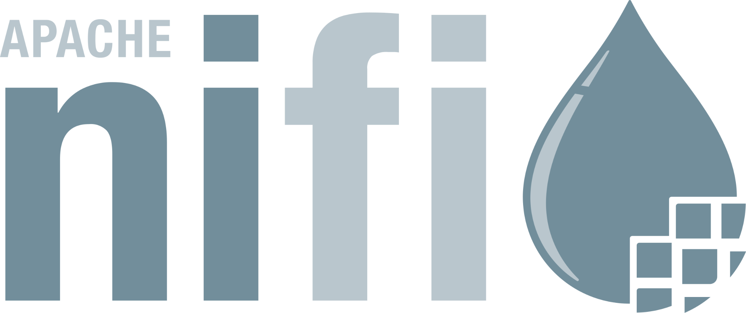
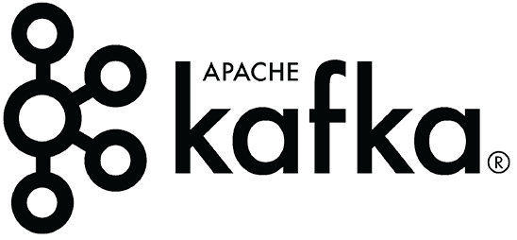
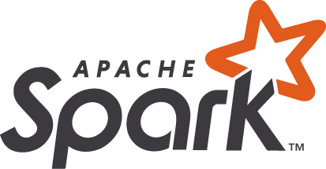


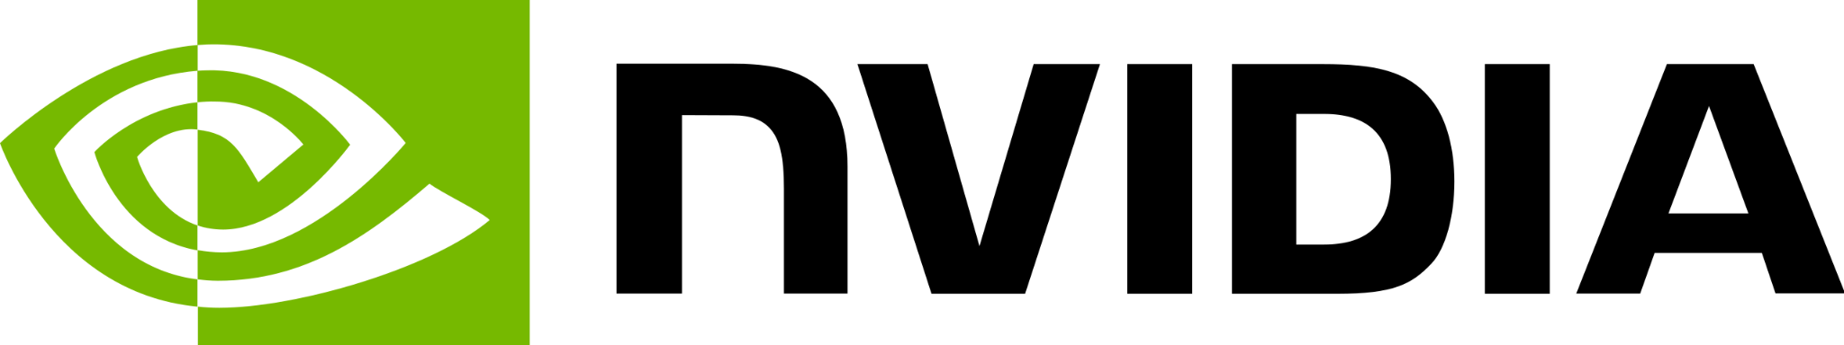

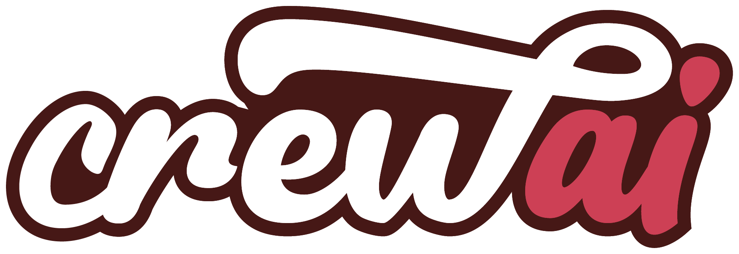
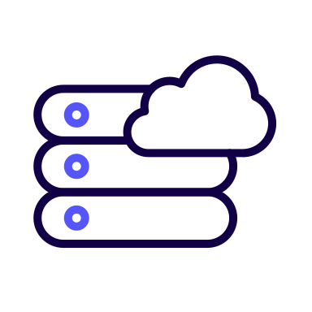


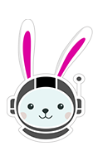
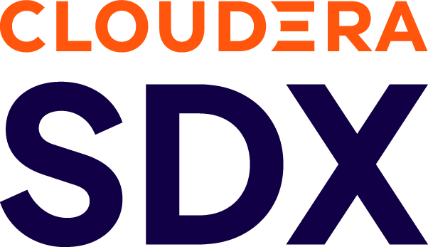
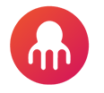

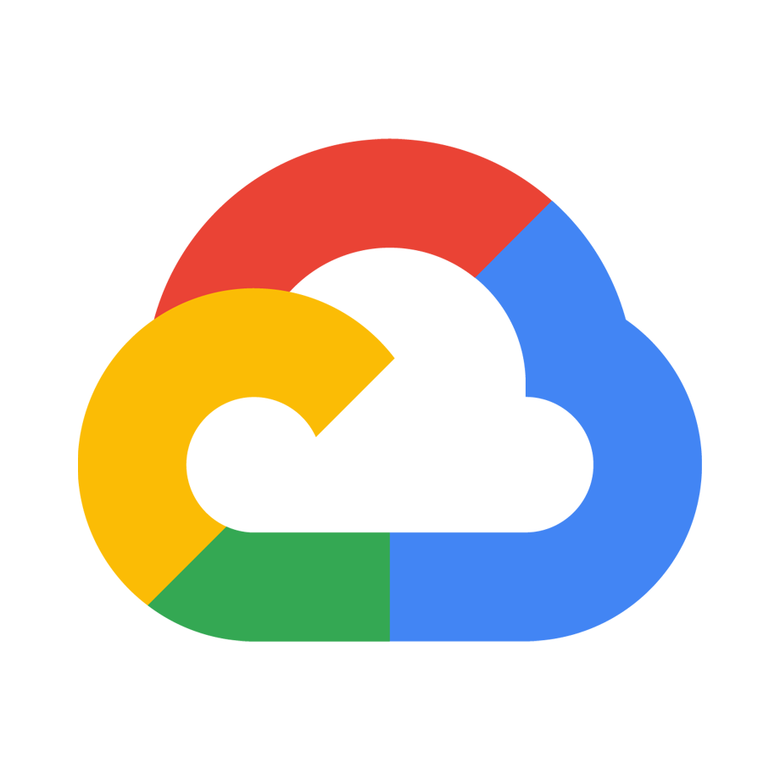
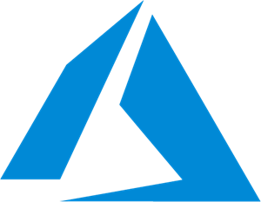

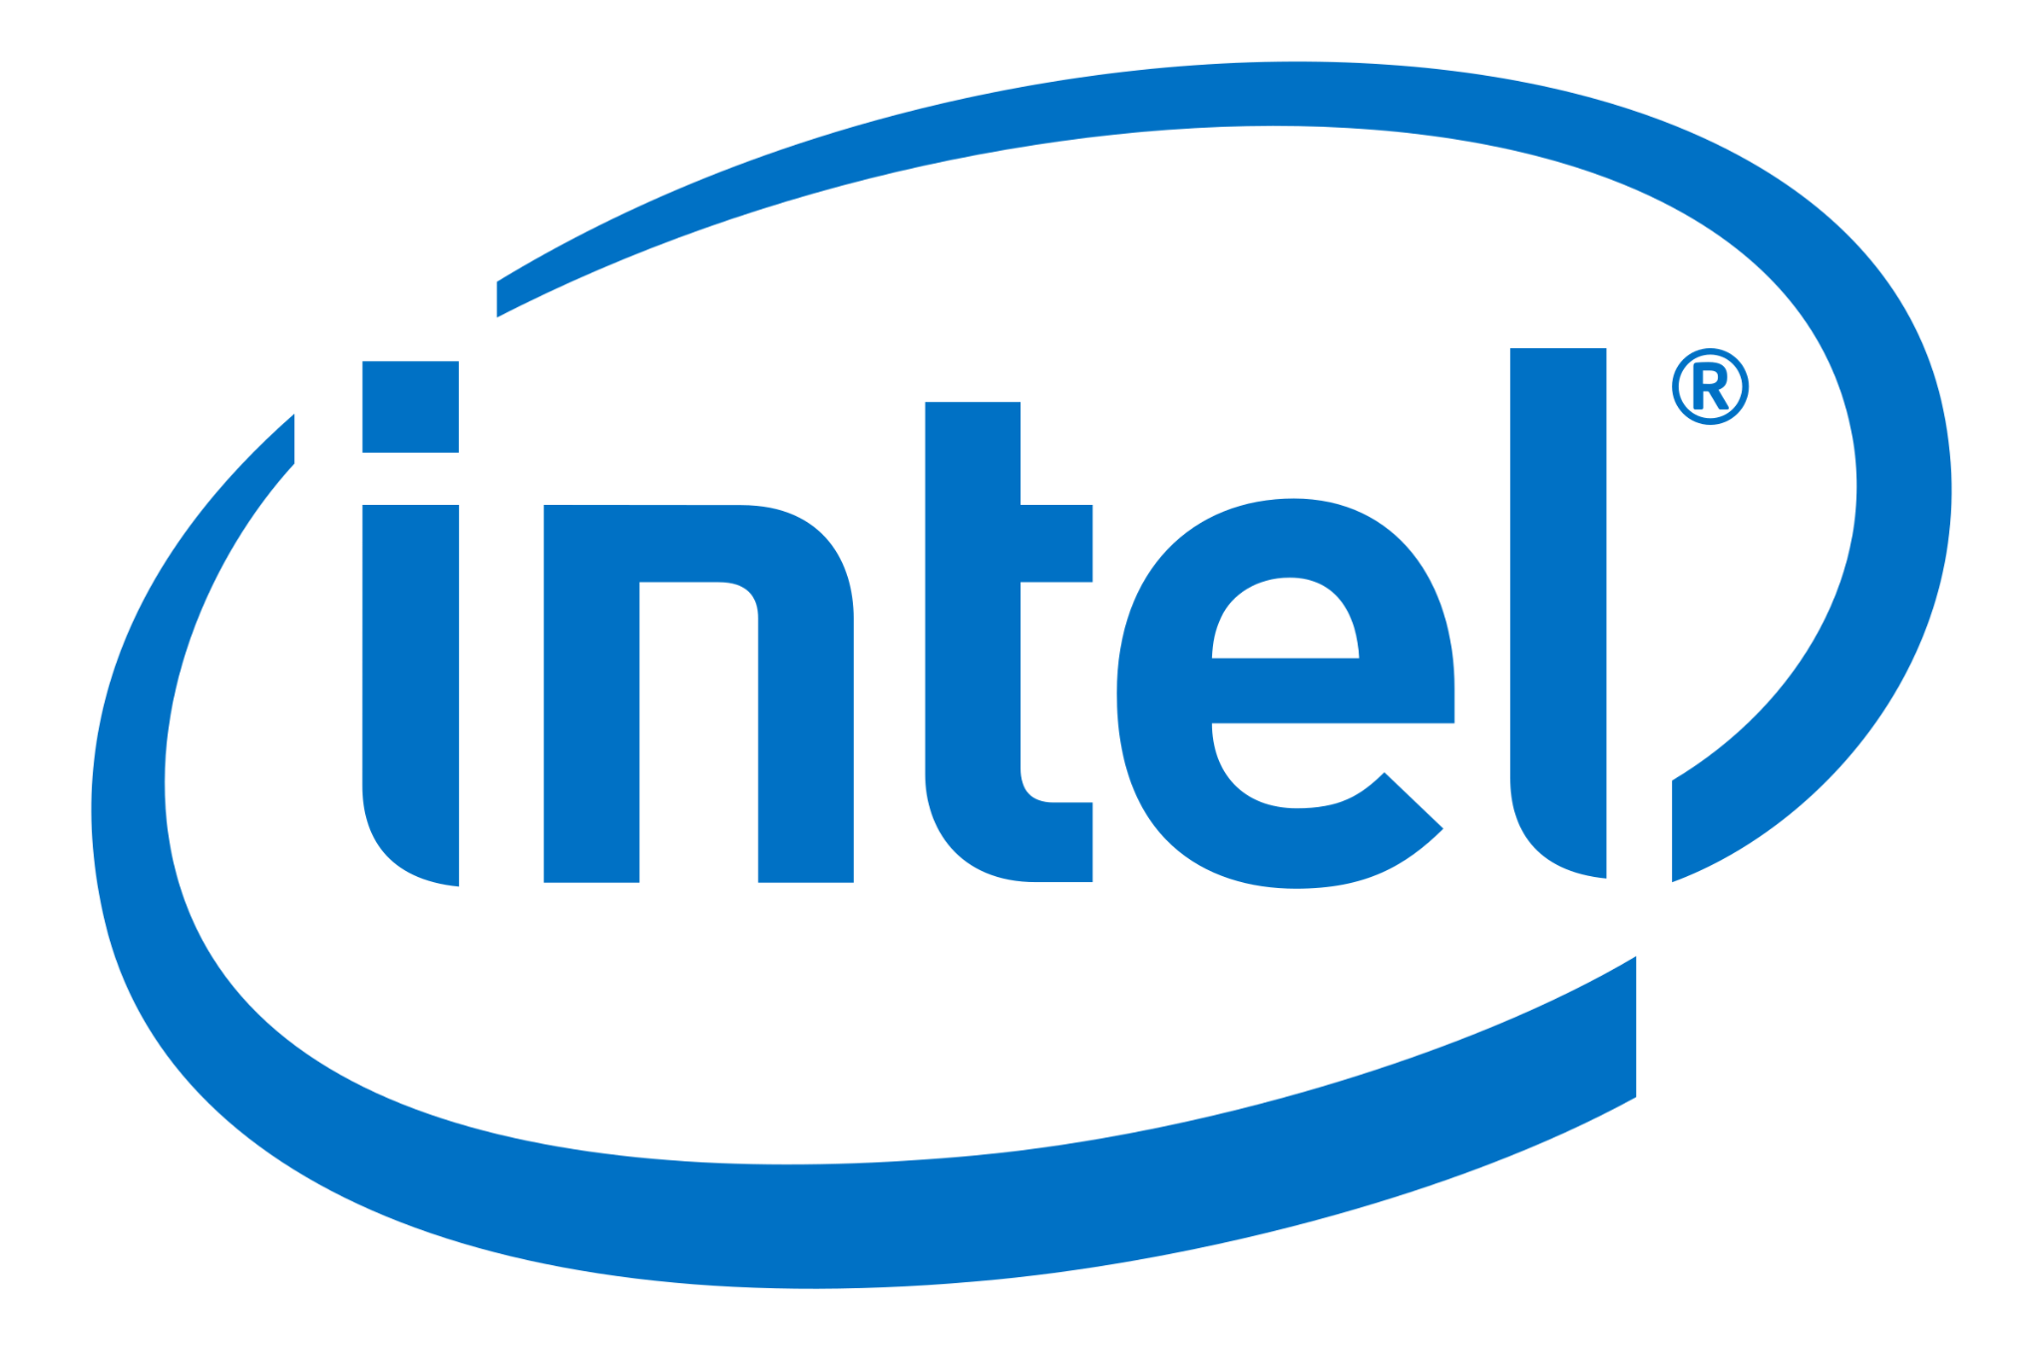

The Cloudera True Hybrid Platform
Strategic Priorities
Enabling Technologies
Data in Motion
Open Data Lakehouse
Enterprise AI
DELIVER True Hybrid
ENABLE Modern Data Architectures
ACCELERATE Enterprise AI
Cloudera Data Flow
Cloudera Data Engineering
Cloudera Data Warehouse
Cloudera Operational DB
Cloudera AI Workbench - Inference - Agents
Unified Data Fabric Security | Governance | Lineage | Observability
The Only True Hybrid Platform for Data, Analytics, and AI Public Clouds | On Premises
Notes:
Anu :organizations are increasingly seeking agile, hybrid and scalable solutions to manage, process, and analyze their data. The increase in AI represents today’s most pivotal data strategy trend
Our unique value proposition lies in our comprehensive and unified platform that combines open-source innovation like open data lakehouse which allows you to keep data in open table formats, data in motion with enterprise-grade security and governance powered by our shared data experience to accelerate your enterprise AI
We lead the industry in providing a transformative Hybrid Platform for data, analytics, and AI that empowers organizations to turn their data into a strategic asset anywhere with complete control

Slide 20
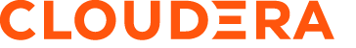
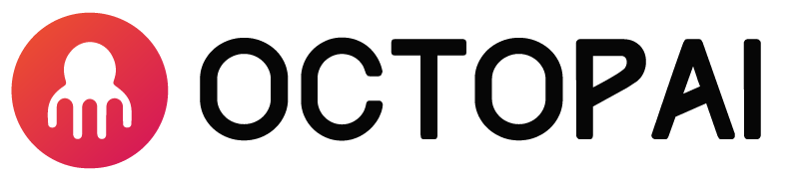



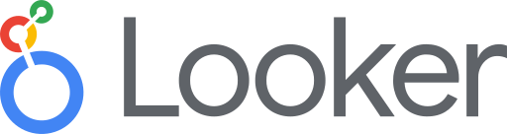












Octopai at a Glance
Hybrid Data Platform
Hybrid Metadata Platform
Enabling Technologies
MAP your entire data estate
VISUALIZE data flows
TRACE changes & impact
COLLABORATE with team members
TRUST your data!
+

Slide 21
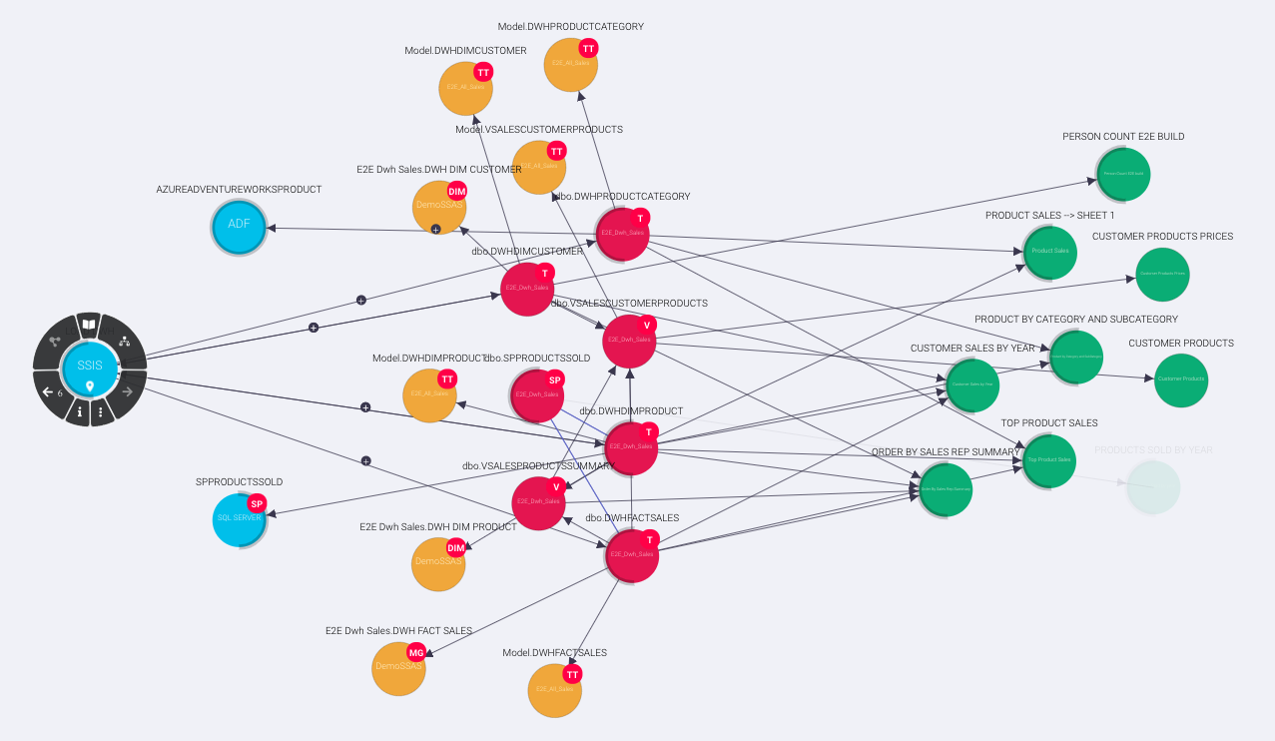
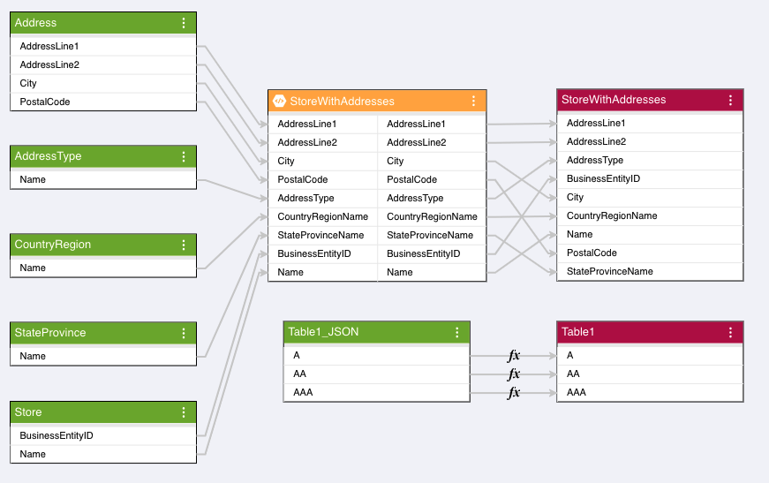
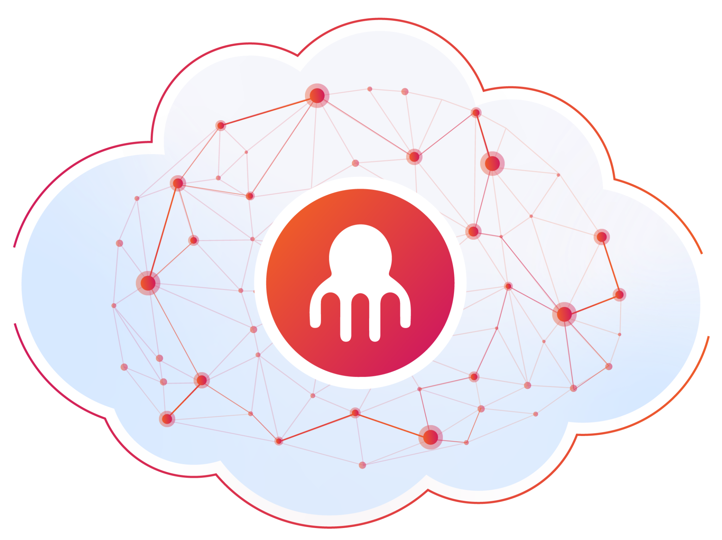

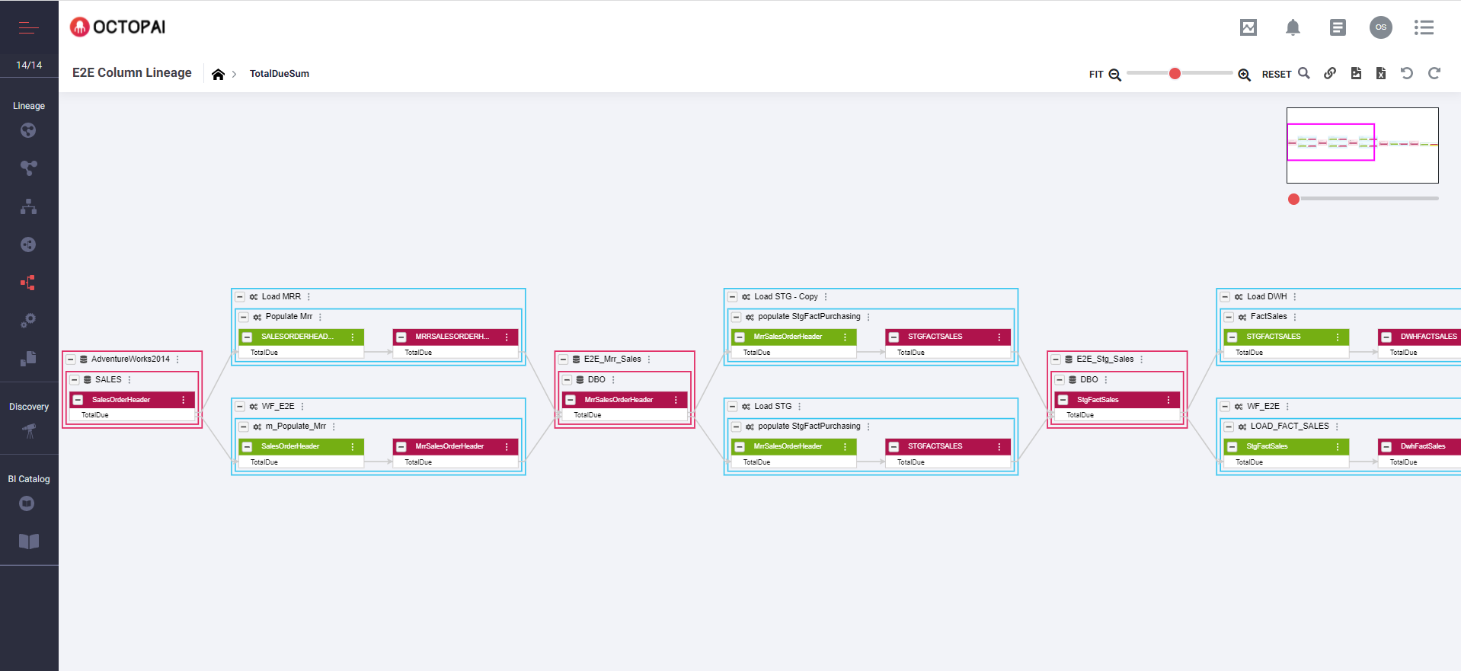
Multi-Dimensional Lineage
Enabling Technologies
#1 Cross-System Lineage
Provides end-to-end lineage at the system level from the entry point, all the way to reporting, analytics and any data consumer
Octopai Knowledge Graph: Unveiling hidden data relationships for smarter decisions
#2 Inner-System Lineage
Details the asset-level lineage within an ETL process, report, or database object.
#3 End to End Lineage
End-to-end asset level lineage between systems from the source system into the end consumer.
DB | ETL | Code | Reporting | Analysis | Files
Notes:
Lineage can be presented based on your use case

Slide 22
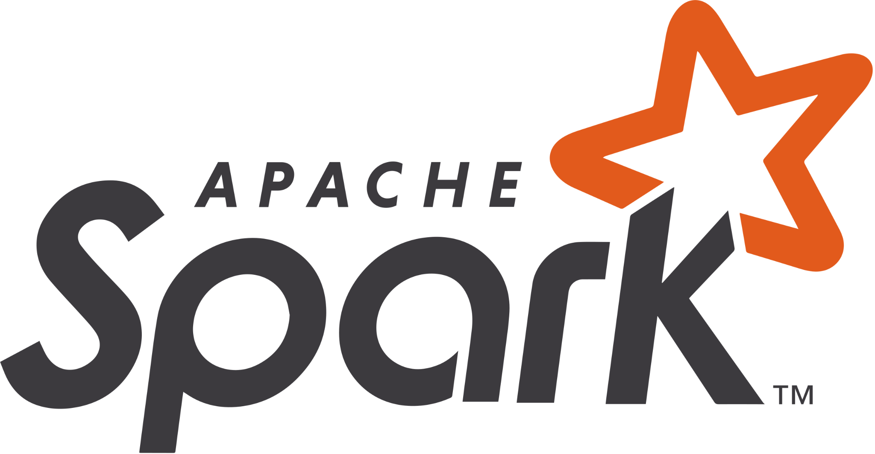

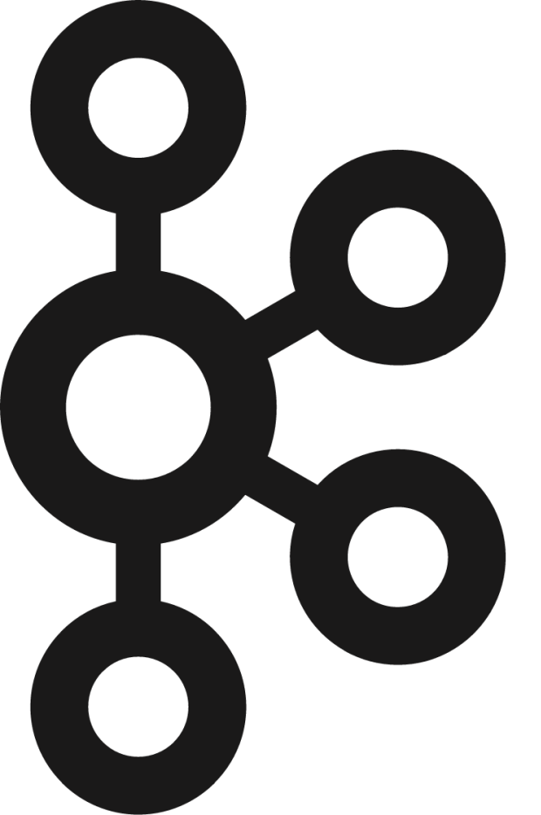
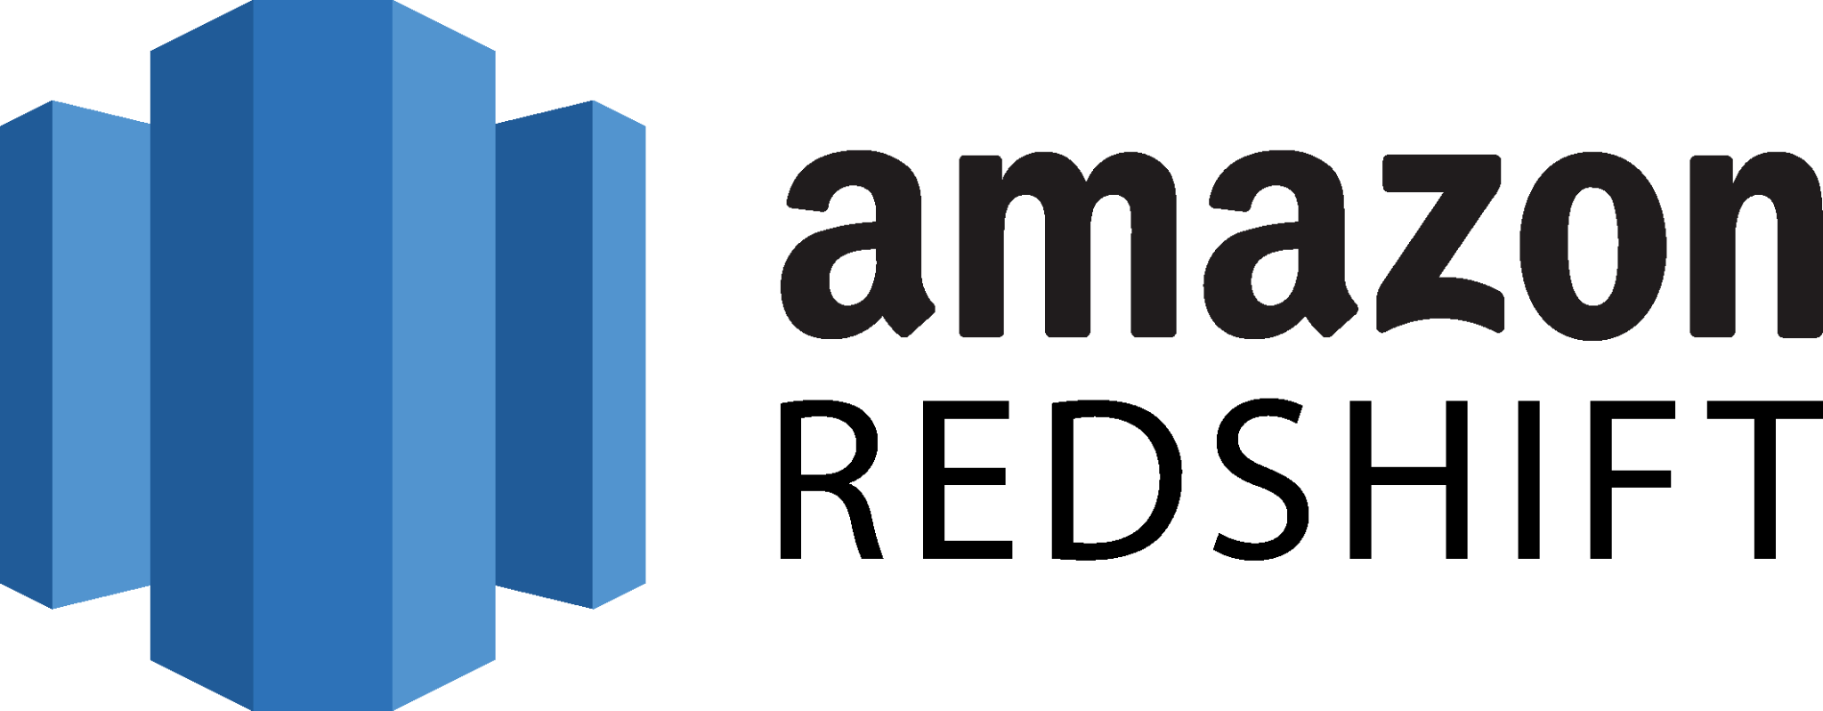


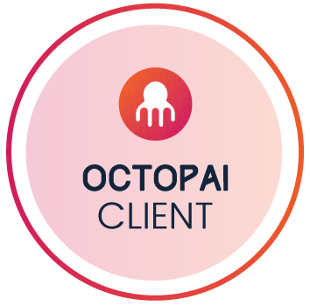














Octopai as a Single Source of Truth for your Metadata
Enabling Technologies
Scattered Data Landscape
#1
Octopai extracts metadata from all major data systems and maps the data flow automatically.
Automated Raw
Metadata Extraction
Octopai SaaS
100%
Automation Low Touch
SaaS
No Resources Overhead
3-48h
Time to Value
Hybrid
Supports OnPrem Legacy + Modern Cloud Integrations
+60 Systems
​​DBs | ETLs | Code | Files
Dashboards | Reports

Slide 23

Immediate ROI Built-In, from Day One
Enabling Technologies
90%
Time Savings
Save over 90% of the time spent on root cause analysis, change impact analysis, migration, and decommissioning of legacy systems, significantly accelerating these critical processes
25%
Cost Reduction
Combat “data obesity” by adopting continuous cleansing routines, and curb escalating cloud expenditures by at least 25%, and ensuring delivery of strategic migration projects in half of the budget
Immediate
Time to Value
Cut the time to resolution from weeks to minutes by automating tasks, allowing teams to swiftly pivot to and accelerate the delivery of strategic projects, thereby significantly enhancing the organization's time to value
X10
Production Stability
Boost quality and stability, reducing reported tickets and shrinking investigation times from days to minutes. Through proactive change impact analysis, it preemptively addresses potential issues, ensuring a seamless and reliable operational framework.
“We’ve seen major time saves of up to 99% – What took weeks in the past now takes hours or even minutes, it’s insane!”
Mark Horseman, Alberta Institute of Technology, Enterprise Information Management
Notes:
Helping with the business case
Time
Cost
Quality
Delivery + time to value

Slide 24
Empowering Data Teams
Enabling Technologies
Aligning Data Lineage with Critical Challenges
Enables Complete Visibility
Uncover inefficiencies and drive savings by illuminating the hidden corners of your data flows
Adopt Best Practices
Streamline data operations and pave the way for seamless AI integration.
Decision-Making Precision
Fortify the backbone of your strategic initiatives with the data clarity provided by Octopai automated mapping
Simplify Audit Preparation
Comply with data regulations by instantly understanding of sensitive data flows and segmentation.
Detect data leakage and run fast incident responses
AI
Readiness
Solidify the foundation of your future AI projects with our solution's robust data structuring, equipping you with the power to act on opportunities with confidence
Elevating Data Quality Continuously
By proactively securing the integrity of your data, you're not just avoiding disruptions; you're fortifying your strategy with preemptive intelligence
Retain Organizational Knowledge
Retain data intelligence in one place and easily onboard new team members. Free your Knowledge Professionals to progress forward
“There is no area of the company that Octopai has not affected positively. We have reduced the amount of ‘busywork’ and simultaneously empowering our department to deliver more direct business value. Confidence and trust in our data has increased a hundredfold - both within data teams and across the company.”
Lance Dobell, Mediolanum, Senior Enterprise Data Architect

Slide 25











Octopai Low Touch Solution Automatically Harvests Metadata
Enabling Technologies
From all major On-Premise and Cloud Data Systems
Octopai identifies the organizational data architecture and instantly builds the data flow maps, with no manual intervention required, ensuring metadata is always up-to-date.
Octopai's innovative and proven technology can analyze all data manipulations and scripts, offering the broadest and most comprehensive coverage for enterprises.
+60
Data Systems
out of the box
DB | ETL | Code | Reporting | Analysis | Files
Link to all 60
DB | ETL | Code | Reporting | Analysis | Files

Slide 26

Customer stories
Payments Co. Fraud Detection
Oil & Gas Co. Edge-to-AI Cybersecurity
Banking Co. End-to-end Enterprise AI / ML platform
Global Pharma Co. Petabyte-Scale Drug Discovery AI / ML Platform

Slide 27

Case Study: Fraud detection in real time on Cloudera
Customer stories
Cloudera Stack to drive end to end Fraud detection
CHALLENGE
SOLUTION
OUTCOMES
Low latency required:
.The system needs to be able to block a transaction
Real time data: Many signals need to come in real time
Critical systems: The system needs to be observable and auditable
HBase for strong reliability for the features
Kafka and Flink for RT features: Keep feature updated
Cloudera AI for model:
Fast model inference
Real time: Low latency thanks to Kafka real time feature and Hbase
Transaction blocking: Ability to block transaction
Ability to evolve: Internally develop to enable evolution and ability to adapt

Slide 28


Deep-dive: Fraud detection in real time
Customer stories
Rule based engine
Transaction RT data
ML inference
API call
Kafka source topic
Flink
Kafka topic
Feature Serving
Transaction data
HBase
Fraud management system
History
CDE Spark
Lakehouse
Model Training
Deploys
Customer data
Monitoring dashboard
ERP
Tables separating last 24 hours for training purpose since they are real time
Lakehouse

Slide 29

Case Study: Top 5 Global Oil & Gas Co. built an unmatched Edge-to-AI capability with Cloudera on AWS
Customer stories
Cloudera AI used as the enterprise-grade solution for AI/ML, given enhanced customizability and configurability, cost performance, integrated security & governance, and overall scalability
Launched a unified cybersecurity application improving time to detection by 90% vs. prior convoluted, non-unified process with 17+ ETL tools
90%
Decrease in mean time to detection via Edge to AI capabilities
130K
“We have worked with Cloudera for many years. We chose Cloudera for the critical technical features we needed to support our enterprise data and analytics needs. They are a partner with us and we have environments in private cloud and public cloud. One of our first major use cases with Cloudera was to look at data from our 30-40 refinery sites globally, aggregate the data, and slice it across the value chain to analyze our processes. In addition, we had a very specific problem that we wanted to solve in the security space where we needed to look across 60 to 70 sources to improve mean time-to-threat detection. – Director, Global Oil & Gas Co.
Number of IoT devices from which logs are ingested

Slide 30
Case Study: OCBC’s streamlining & ruthless rush to AI
Customer stories
Limited use case - Building foundation
First Real Production Scale ML
GenAI
Agentic AI
100 models
200 models
300 models
2021
2022
2023
2024
KYC name screening models for SG (batch)
Targeting Marketing batch model
Chatbot (not GenAI)
Rule based Engine for targeting
Transaction screening model (batch)
Risk models
GenAI bot
Wingman (coding assistant)
Real time recs
Speech to text
Real time scam detection
Real time KYC on 4 Channels
LLM Cluster
KYC onboarding assistant
GenAI chatbot rolled out to 10 channel
Document AI
Agentic RAG
GenAI powered insight for RM
…
On premise AI + 35 DS covering the entire AI/Data science sphere

Slide 31






















OCBC: Cloudera AI is modular yet powerful. Customers can build full AI applications on top
Customer stories
Data Pipelines
End Users
GEN AI APPS
ORCHESTRATION & AGENTS
CHUNKING & EMBEDDING
VECTOR STORE
LLM REPOSITORY
System Integrations
MODEL SERVING & AUTO-SCALING
CRM
LLM-as-a-SERVICE ENDPOINTS
Contact Centre
openAI endpoints
guardrail-ai
FLARE, Hallucination
Operations
Phoenix
CLOUDERA AI

Slide 32



OCBC: Some AI and GenAI applications
Customer stories
Real time Fraud detection
Fine tune Vision model for contract parsing
Agentic AI for private banking customer onboarding
Leverage CAI for Fraud detection with P90 of 17ms. Deployed a RT fraud scoring with RT features and historical features
Technology: Kafka, Flink, CAI.
Outcome: +50M $ of scam avoided, Recognised by regulator
Developed a multi step agentic workflow to process up to 600 pages of onboarding documents to perform KYC
Technology: CrewAI, CAI, Llama, miniCPM.
Outcome: 10+M$ cost improvement
Fine tune a Vision language model to match derivative contracts against Trading system
Technology: CAI, S3, Murex, Llama, MiniCPM
Outcome: +6FTE reduction + reconciliation within 1 hour

Slide 33
Case Study: Global Pharma Co. built a leading drug discovery capability with Cloudera on AWS
Customer stories
By the numbers…
Impact at Scale
840K+ drug hypotheses delivered
Developed Cloudera AI as the “platform of choice”
Doubled R&D productivity
Vendor & deployment flexibility via Cloudera’s open, hybrid & multi-cloud platform
Optimized cost & performance via Cloudera compute efficiency and NVIDIA NIM partnership
500K
1B+
Tables
Knowledge graph edges
170
32M+
Sources
Knowledge graph nodes
25
300
Petabytes of data
Users

